Slide 1
Data Analyst Internship-Dashboard task
Interactive Sales Dashboard
Name:-Harsh Borkar
Date:-25th September 2025
Tool used:-Power BI

Slide 2
Objective and Dataset
Objective: Design an interactive dashboard for business stakeholders to analyze sales performance using Power BI.
Dataset:
Source: Superstore Sales Dataset
Type: Sales/Financial data from Kaggle

Slide 3
KPIs & Dashboard Features
Key KPIs Used:
Total Sales
Total Profit
Sales Growth (Year-wise)
Dashboard Features:
Region and Year slicers
KPI Cards for summary
Pie chart: Sales by Region
Bar chart: Sales by Category
Line chart: Time-series trend

Slide 4
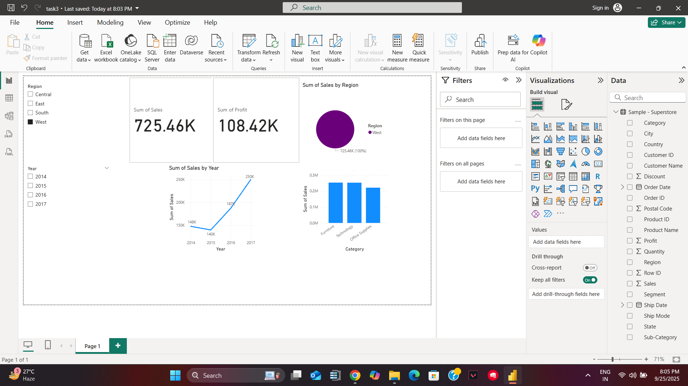
Power BI Dashboard View

Slide 5
Insights & Learnings
Insights:
West region led sales performance
Technology & Furniture were top categories
Consistent growth over 4 years
Learnings:
Built end-to-end dashboard using Power BI
Used slicers and visuals for interactivity
Improved understanding of KPI reporting

